Slide 1

An Integrated IoT-Based Non-Invasive System for Glucose Monitoring and Foot Ulcer Detection
ASHUTOSH SRIRAM
GOPIKA N
CHANDHANA S

Slide 2
Introduction
Diabetic patients and elderly often face foot complications.
Monitoring temperature, pressure, and glucose non-invasively can prevent serious issues.
Goal: Build a compact, modular system that integrates multiple sensors for real-time monitoring.

Slide 3
Objectives
Hotspot Detection: Use 4 thermistors to detect areas with elevated temperature on the foot.
Presence Detection: Use an FSR (Force Sensitive Resistor) to detect if the foot is in position.
Glucose Monitoring: Use MH-ET NIR sensor to estimate glucose levels non-invasively.
Data Integration: Combine readings to give real-time alerts or feedback.

Slide 4
Components
Thermistors (4x): Measure surface temperature at specific foot points.
FSR: Detects foot presence and can be used for weight deduction
MH-ET NIR Sensor: Measures near-infrared reflectance for glucose estimation.
Microcontroller: Arduino Uno for sensor integration.
Power Supply: Battery or USB source.

Slide 5
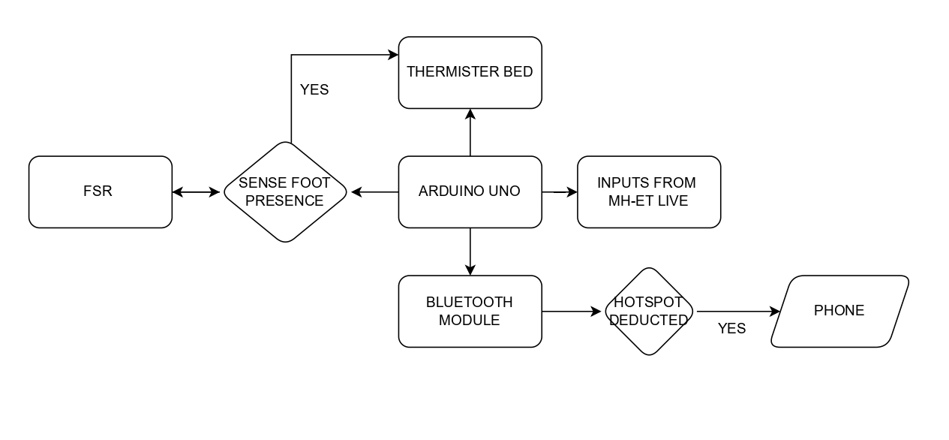
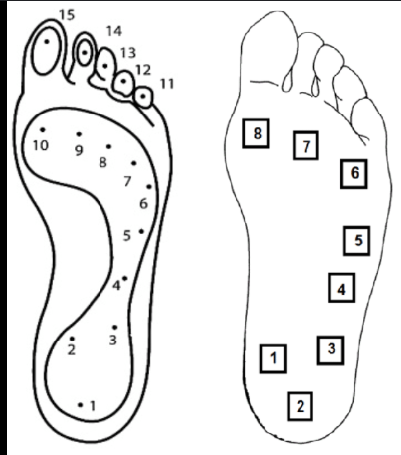
Working Principle
Step 1: FSR detects foot placement → system becomes active.
Step 2: Thermistors measure temperatures → identify hotspots.
Step 3: NIR sensor measures foot tissue → correlate with glucose levels.
Step 4: MCU processes data → outputs alerts or logs readings.

Slide 6
Applications
Diabetic Foot Monitoring → prevent ulcers or infections.
Elderly Care → detect abnormal foot temperature or pressure.
Non-Invasive Glucose Tracking → support continuous health monitoring.

Slide 7
Advantages
Real-time feedback → preventative care.
Non-invasive glucose estimation → pain-free monitoring
Early ulcer deduction

Slide 8
Future Work
Integrate mobile app or dashboard for data logging.
Improve NIR calibration for glucose accuracy.
Mobile dashboard UI upgrades
Machine‑learning hotspot prediction
Cloud logging + analytics
Integration with Wi‑Fi / LoRa

